Slide 1
Mitigating risk within iManage using Cyberseer MSSP
Webinar series: 28th April 2020
Presented by Martin Cook
and Sam Humphries

Slide 2






What you’ll take away from today’s webinar
It’s our way of saying thanks!
Your organisation’s iManage deployment and challenges.
Scenarios and threats that can affect your data.
How does the Exabeam & Cyberseer solution address this?
The benefits of Exabeam & Cyberseer's approach.
And of course a food voucher or a donation to the NHS.
Martin Cook
Strategy Director
Cyberseer
Sam Humphries
Security Strategist
Exabeam
Notes:
Mitigating risk within iManage using Cyberseer MSSP

Slide 3

Why is visibility so important?
Document Management Systems
Version Control
Security, Risk & Governance Control
iManage
O365 Integration
Access Anywhere
Search
Meta-Data
Document Archiving
Document Retrieval
Workflow
Notes:
Transcript
Without being able to effectively monitor your estate then your organisation will be open to all sorts of sophisticated attacks!

Slide 4
Scenarios & Threats

Slide 5


External Threats
Phishing
Compromised Credentials
Malware
Social Engineering
100% of the Top 100 law firms
had a cyber security incident during 2018-19
Source: https://www.pwc.co.uk/industries/law-firms/pwc-law-firms-survey-report-2019.pdf

Slide 6


Insider Threats
75% of Top 10 and 90% of
Top 11-100 law firms have experienced insider threat incidents in 2018/19
Source: https://www.pwc.co.uk/industries/law-firms/pwc-law-firms-survey-report-2019.pdf
Malicious (ex)Employee
Careless Employee
Curious / Bored Employee

Slide 7


Plus
Software vulnerabilities
Misconfigurations
Inflated privileges
Password re-use
80.5% of law firms were running at least one service with a well-known vulnerability
Source: https://www.kynd.io/wp-content/uploads/2019/11/Fraud-and-cybercrime-vulnerabilities-in-the-legal-sector-FINAL.pdf

Slide 8




iManage DMS Threats?​
Basic monitoring within iManage will not identify the below threats:
Abnormal: activity within iManage DMS
creating
modifying
exporting
Abnormal: number of files accessed or exported
Abnormal: executive management activity within DMS
Abnormal: access from source device, time of day / week

Slide 9
How do we spot these instances?

Slide 10
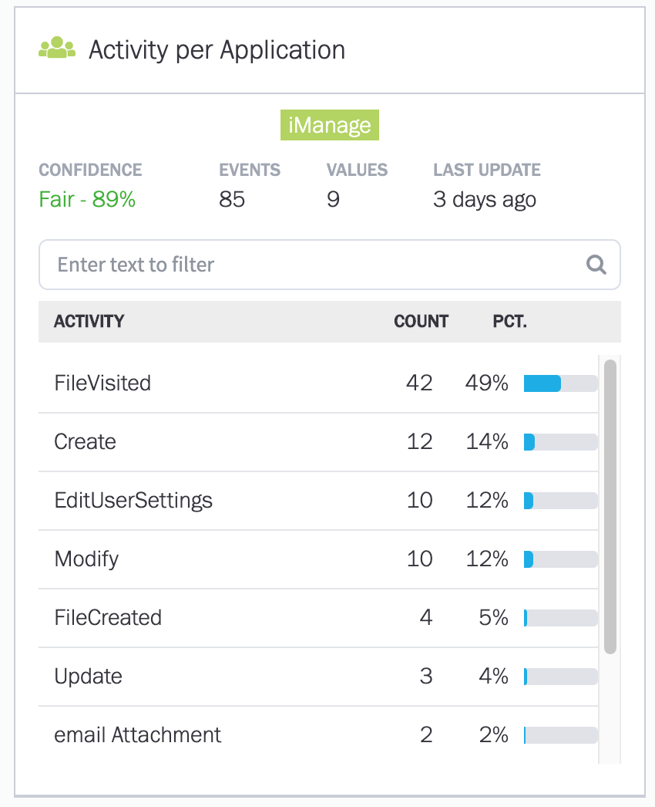
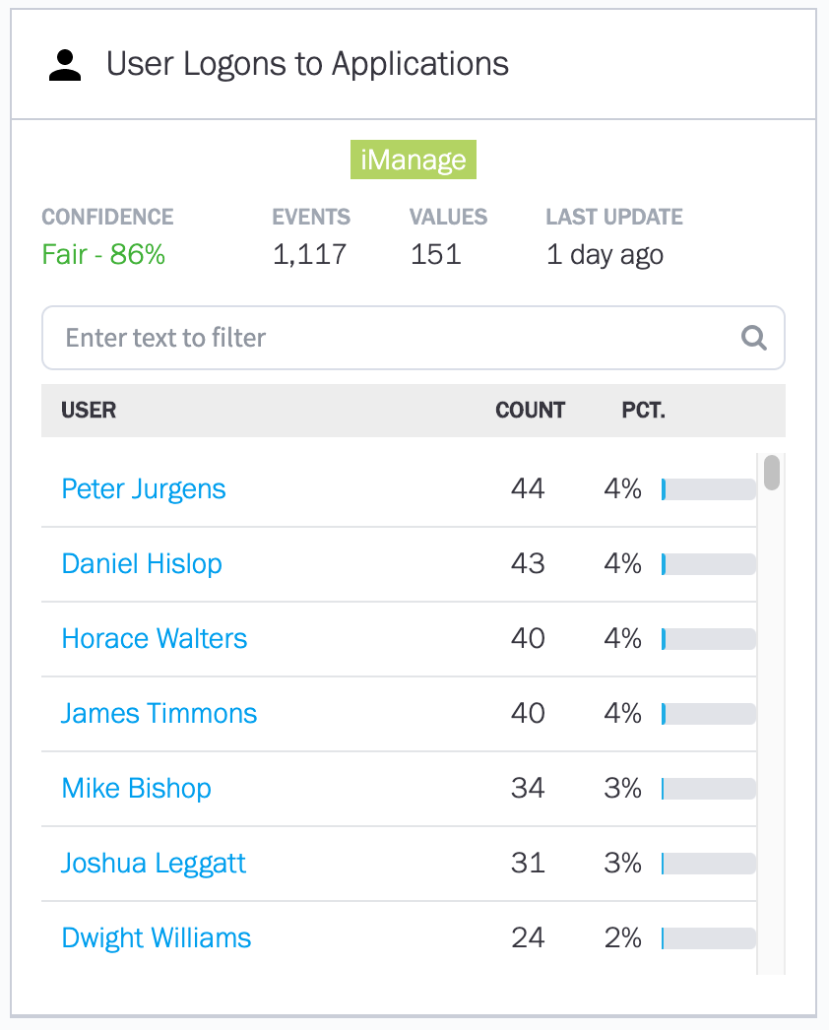



Data Models
Data Models provide the backbone for anomaly detection based on activity observed
Model observed activity for each user across multiple vectors
Data Model results are compared to received log data and all deviations from the model are raised as anomalies
Enables granular identification of behaviour change

Slide 11
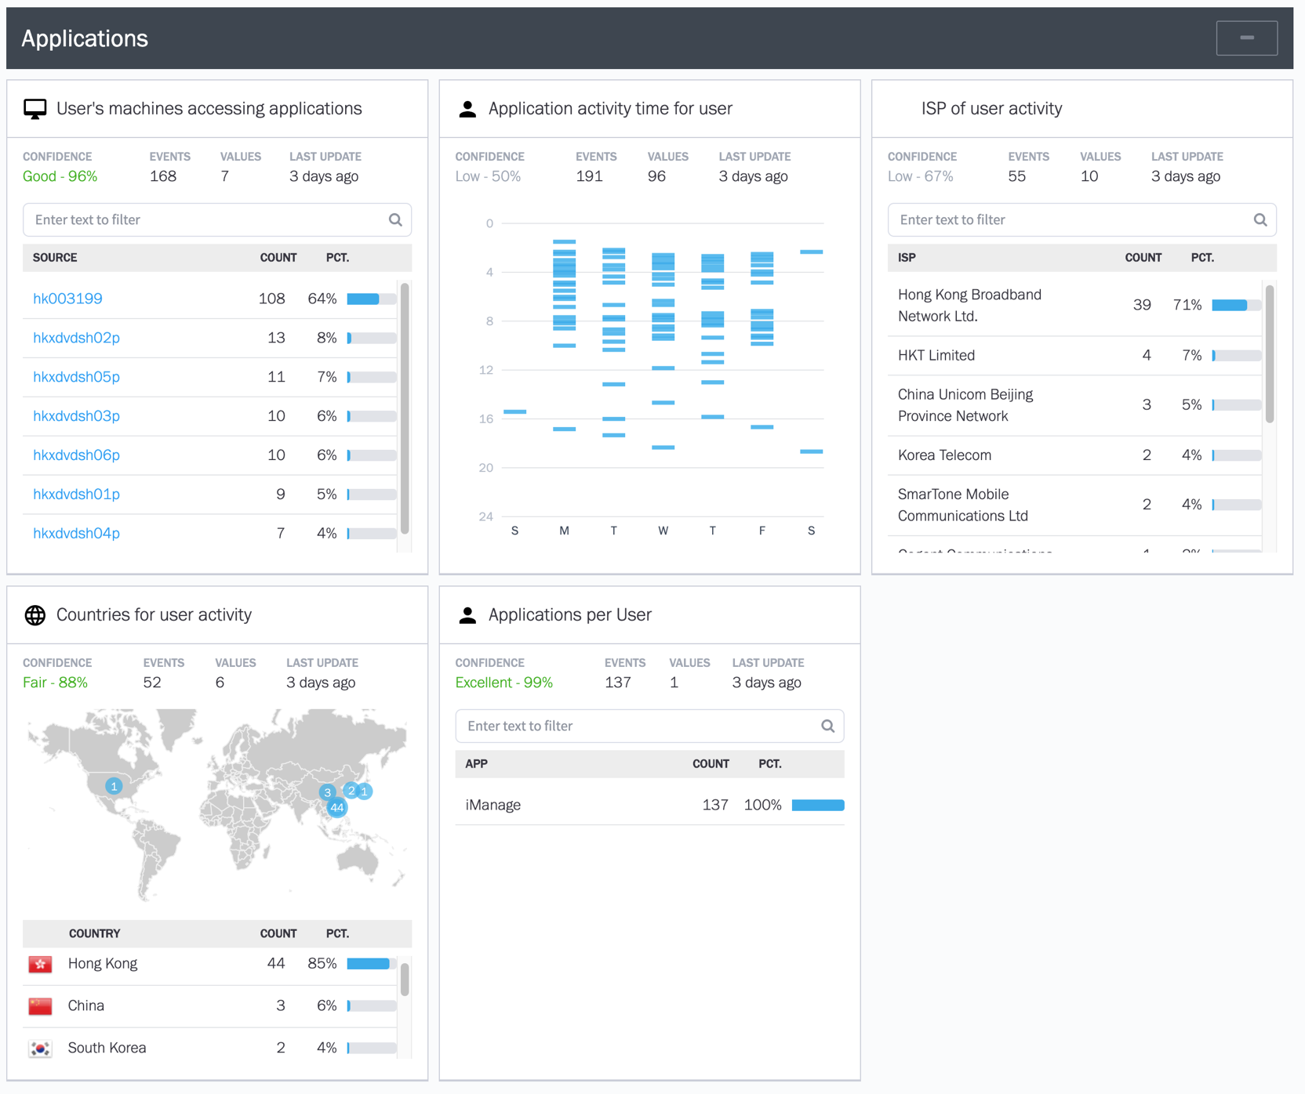
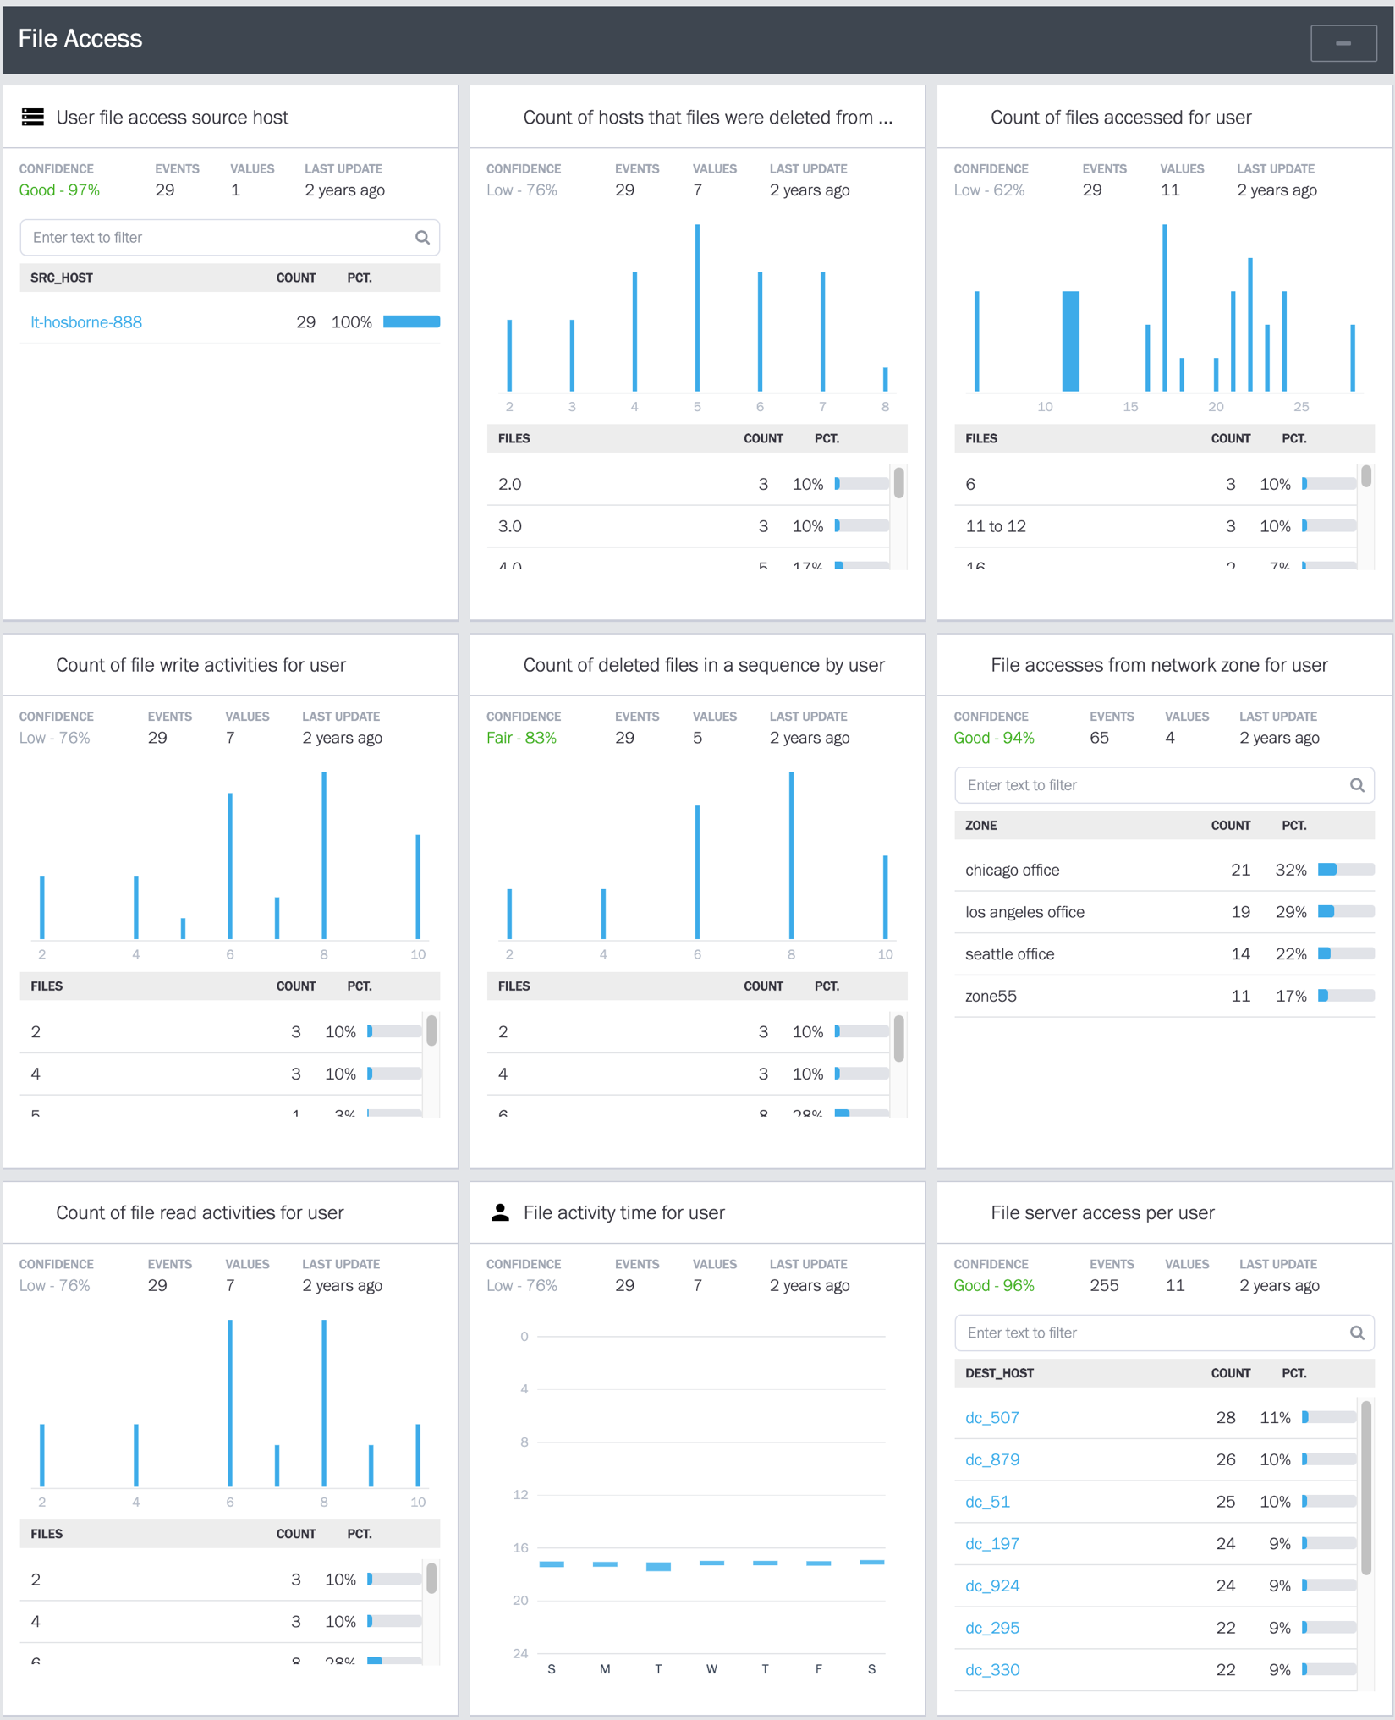
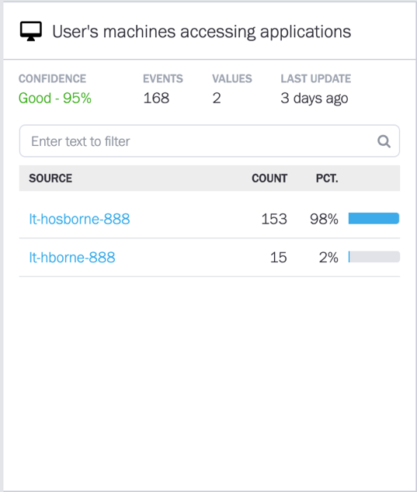
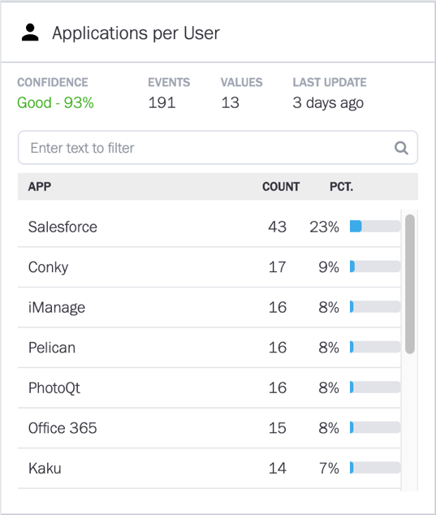
Data Models

Slide 12
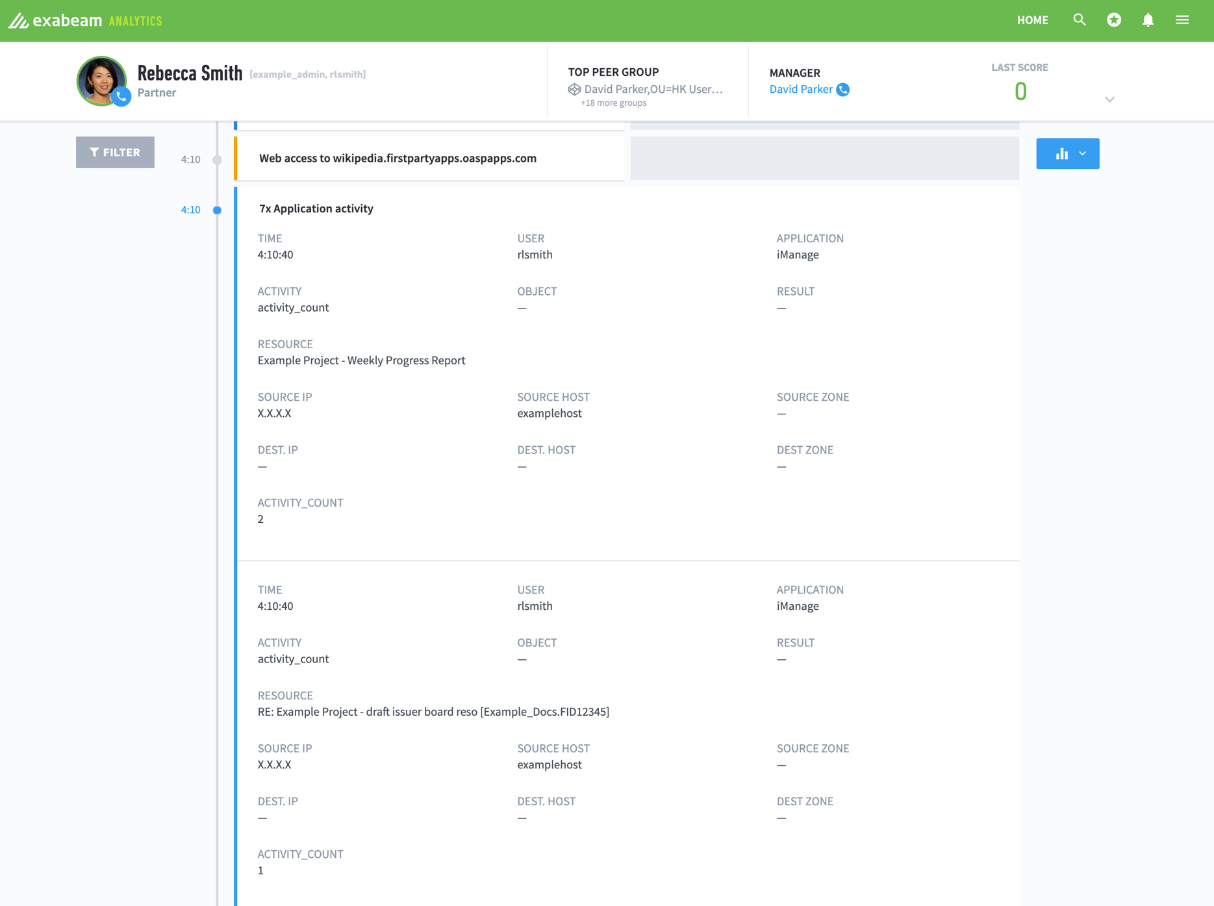
Timelines

Slide 13
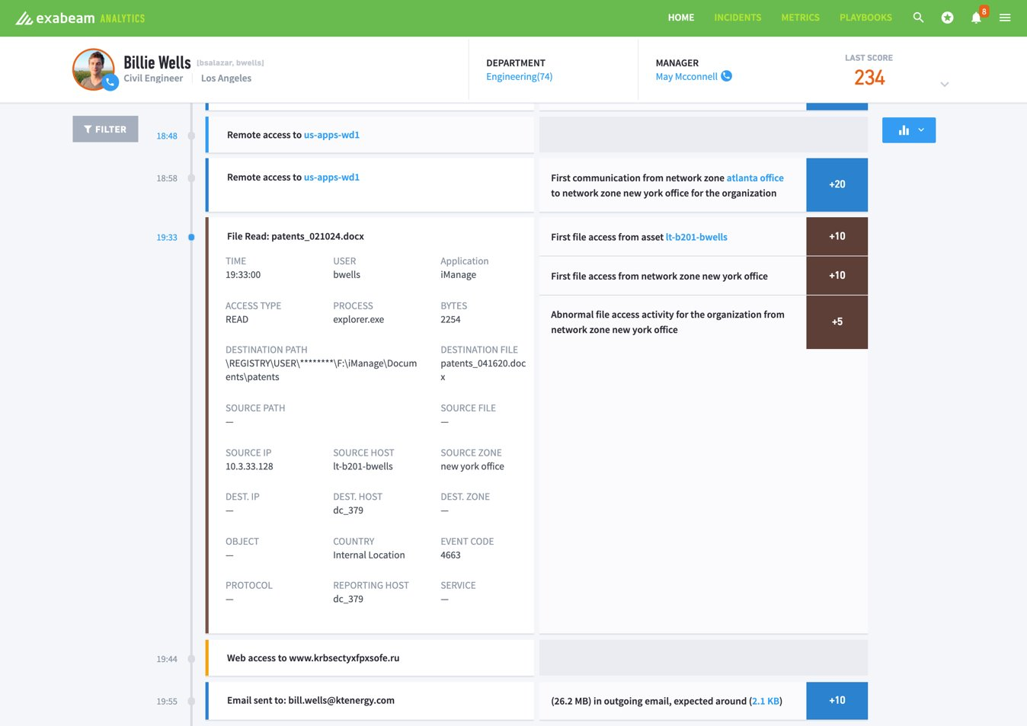
Timelines

Slide 14
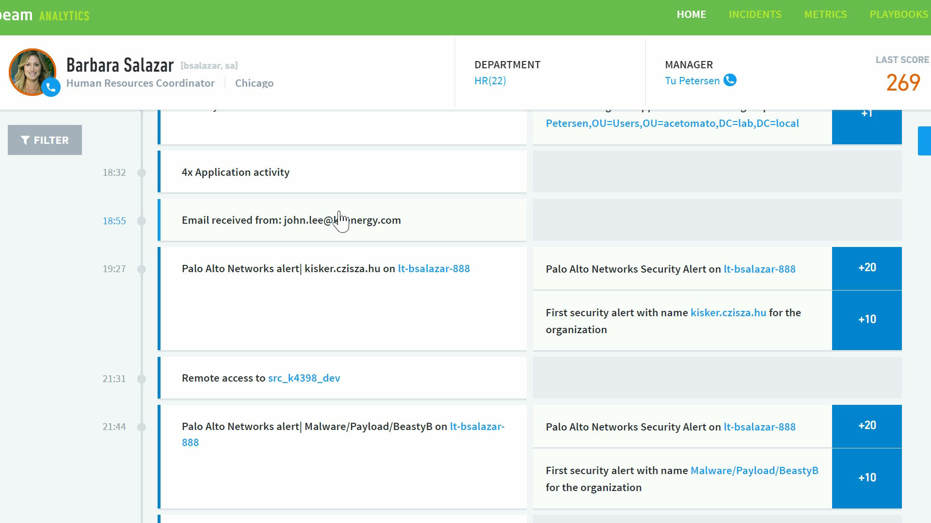

Slide 15
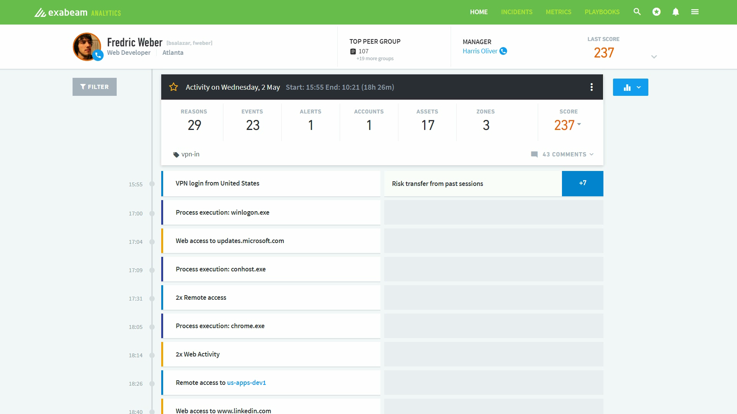

Slide 16

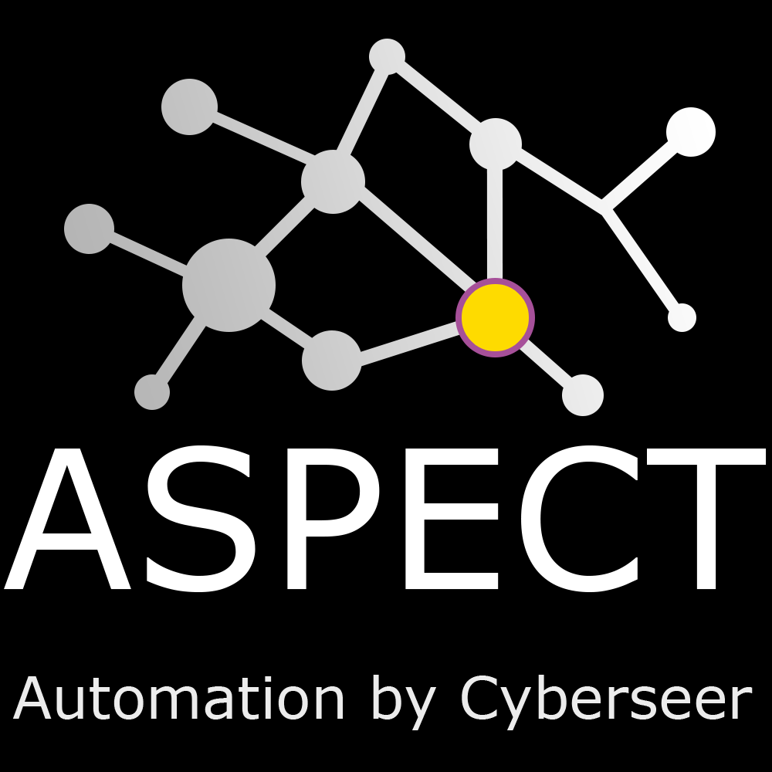
It’s called...

Slide 17



How do we spot these instances?
It’s as simple as collect, automate and act!
3. Act
Our forensic analysts then make informed decisions based on the intelligence received.
2. Automate
The identified activity is enriched utilising threat data building and a contextualised series of alerts.
Ready to react!
1. Collect
We collect data from the monitored estate and identify alerts and anomalous activity.
Always Automating!
Constantly Analysing!
Notes:
Michael takes over
Transcript
Michael, can you tell us how we can spot these instances quickly amongst all this data?

Slide 18
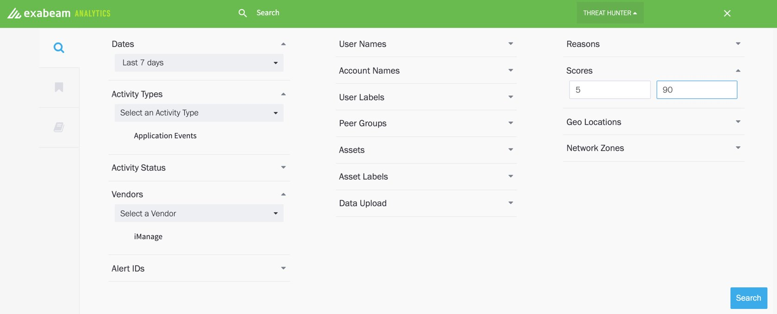
Threat Hunting

Slide 19
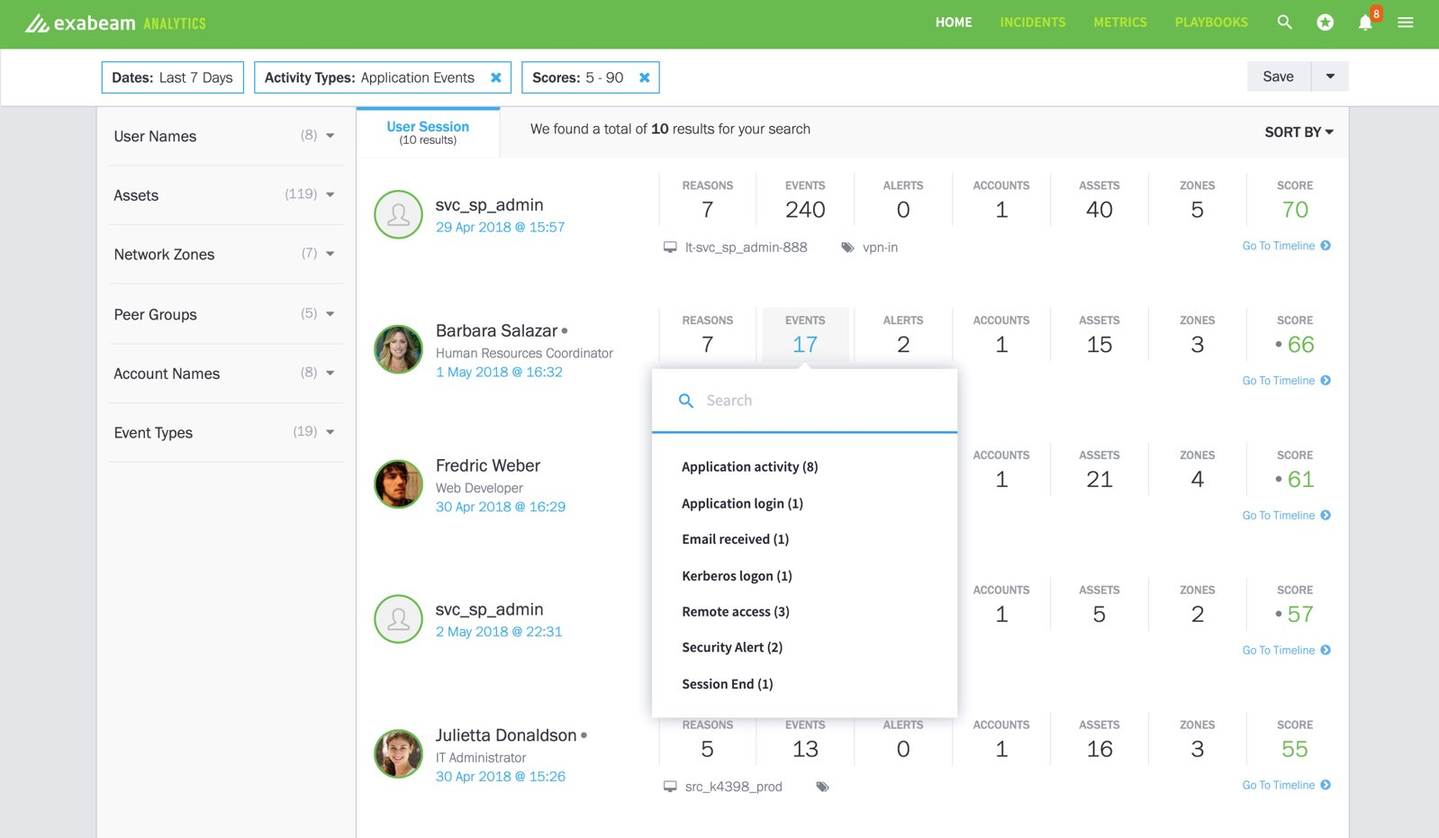
Threat Hunting

Slide 20



How do we spot these instances?
When combining technologies with analysts we can do...
✓ Improving accuracy​!
✓ Improving speed!
✓ Keeping costs low!
Notes:
✓ Do more with less
With automation we can analyse large quantities of data with less people. Removing Tier 1, Tier 2 analysts and SOC personnel.
✓ Greater accuracy​
ASPECT is more accurate than a human as it orchestrates a prescribed path to delivering a meaningful output to our analysts.
✓ Enhancing your security posture
ASPECT allows us to make informed decisions in a shorter timeframe that reduces the time to detect whilst enhancing your security posture.

Slide 21


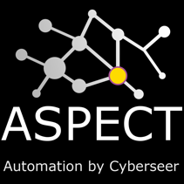
Cyberseer Solution Overview ​
Your SOC
Scheduled reports
Alerts
Existing Log flows
Collection
Detection
Automation
Investigation
IAM
Visibility
Detection
Cyberseer Threat
Analysis SOC​
Data Lake
Advanced Analytics
Notes:
TITLES TO BE ABOVE – DOUG TO DO TWO VERSION

Slide 22

Features and Benefits of Cyberseer’s MSS
Advanced Threat Management
Detection & Management of threats early.
Full Visibility
Have full visibility of your organisation’s environment.
Automated Monitoring Platform
Rapid, custom classification enhances alert accuracy and context.
Skills Gap
Reduce the need to recruit, train and retain specialist resources
Smart People
Staffed by creative and inquisitive forensic analysts.
Reduce Dwell Time
Increase the speed of detection using smart tools and smart people
Dedicated
Reliable
Proactive
Creative
“With this managed service we have increased confidence in our security, which translates into a more stable environment for our staff and customers.”
Head of Enterprise Architecture
Markerstudy
Notes:
SOMEHOW ADD CUSTOMER CENTRIC APPROACH

Slide 23




Exabeam & Cyberseer
Employee working remote
Compromised Credentials
Accidental Corruption
Malicious Insider
Easily identify legitimate remote access
Detect potential credential misuse immediately
Identify potentially harmful actions that were executed innocently
Identify anomalous internal activity against any user
Exabeam & Cyberseer detection simplified
Utilising Exabeam Smarter SIEM technology and Cyberseer’s ASPECT platform; Cyberseer are able to detect and investigate all anomalous activity swiftly to maintain a strong security posture for the customer.
Notes:
Types of activity observed by our Service as a result of having enhanced visibility across our customers estates include:
Data Exfiltration – Lady downloaded info – Michael found it and alerted customer
where the service has protected organisations or where you have identified stuff that has saved them.

Slide 24

Any questions?

Slide 25

Thank you for joining us today!

